Slide 1
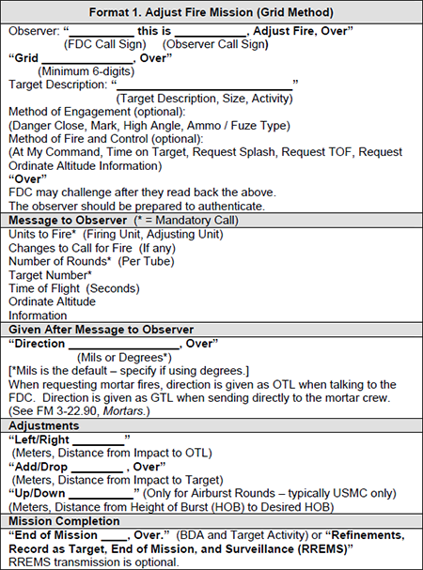
Initial contact between you and the Fire Direction Center (FDC). Provides enough information for them to get ready.
“Black Dragon this is Redstorm 01, Adjust fire, OVER”
“Grid Papa Lima 1 2 3 4 5 6, over”
“Enemy troops in compound – Danger Close, request smoke to mark target, request splash, over”
FDC contacts you back with the details of your mission after they plot on maps/computer. “Splash” is the term that lets you know the artillery has fired and the round is on the way. Get ready.
“Redstorm this is Black Dragon, one round smoke, TOF 23 seconds. Splash – Over”
“Black Dragon this is Redstorm – Splash Out” Lets them know you understand a round is enroute.
You provide your distance and direction to the FDC by distance and direction so they can plot. NOTE – do not provide your grid so you do not accidentally get plotted as an artillery target.
Black Dragon this is Redstorm – Direction 120 Degrees magnetic”
Adjust the impacts using bracketing until your rounds impact within 50 meters of the target. At that point, issue the command “Fire for Effect”

